Slide 1

Bench Buddy
By: Cole Thalacker, Austin Decker, Nick Bolles and Michael Osen

Slide 2
Introduction
At large scale events (sports, concerts), fans rarely want to get out of their seats to go get food or look for merchandise
There is only a limited amount of time for watching replays on the big screen, so this app will also allow fans at sporting events to get more replays from the game
Fans will also be able to see who of your Facebook friends are at the game through the app

Slide 3
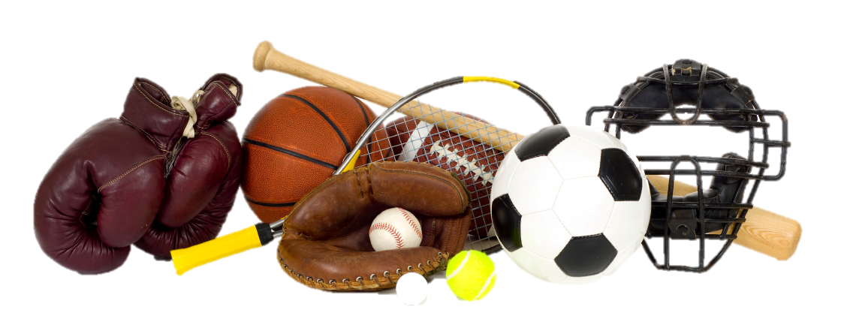
Oppurtunity
Fans do not want the hassle of getting out of their seats to order food during the middle of the game because they might miss something
Different sporting events and concerts allow the opportunity to be able to bring food and merchandise to the customer

Slide 4
Proposal
An app that will be the center of your experience at an event
Promote sales of concessions and merchandise by making it convenient to order and receive them
More replays at sporting events in case a person misses them during the game
Connecting with others that are at the game through social media

Slide 5
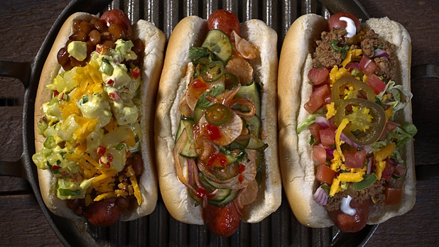
App Features
Watch replays with different camera angles
Purchase Merchandise
Connect with friends that are at the game through Facebook.
Order food, refreshments
and merchandise
Get your order delivered
straight to your seat

Slide 6



Technology
The app should be written in Java for Android and Objective C for IPhone to utilize the native capabilities of Android and IOS
Geolocation – Unlocks an event if the device is in a certain area
The Backend would be built with NodeJS and use a very efficient NOSQL database of all of the events, merchandise, food etc.
Streaming Technology for Replays
Strong networking in Stadiums, such as Wi-fi

Slide 7

Risks
Would need people to actually download the app
The amount of data or Wi-Fi the app would use
The concessions may end up with too many deliveries at certain points during an event
The event would need to hire more workers to deliver food, drinks, and merchandise

Slide 8
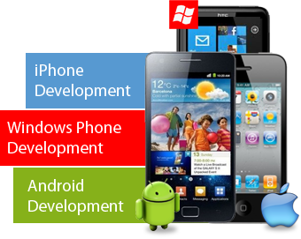
What We Need
$7,000 to develop the app
Software for development
Servers and databases to hold the necessary information
$1,000,000 for multiple national TV commercials
May need to advertise locally as well

Slide 9
Conclusions
This app can be used at sporting events and other large scale events
The app has a few different functions:
Food, drink, and merchandise delivery
Ability to watch different replays and highlights
Connect with friends through social media
We believe this app will really help people at different events in the future

Slide 10
References and Sources
http://www.forbes.com/sites/allbusiness/2013/10/30/how-to-build-your-first-mobile-app-in-12-steps-part-1/
http://www.forbes.com/sites/allbusiness/2013/11/14/how-to-build-your-first-mobile-app-in-12-steps-part-2/
http://appmuse.com/appmusing/how-much-does-it-cost-to-develop-a-mobile-app/
http://smallbusiness.chron.com/much-television-advertising-really-cost-58718.html

